Slide 1

AI Coder: Vibe Coder to Agentic Engineer
The Missing Manual
Week 1
Day 5

Slide 2
3 Weeks to Expert Agentic Coder
Core skills
Products / Features
Projects
Week 3: Agentic Engineering as an expert
Multi-Agents
Sub-Agents
Hooks
Sandboxing
Large Codebase
Workflow
Swarms
Orchestrators
Project 4: Capstone
Week 2: Vibe Engineering as a professional
Claude Code
OpenCode
others
Commands
Checkpoints
Ralph Loops
MCP
Skills
Plugins
Workflows
Team
Debugging
Project 3: SaaS Platform
Week 1: Vibe Coding for fun and profit
Agentic Coding Landscape
Foundations
AGENTS.md
Context
Cursor
Copilot, Codex
Antigravity
Project 1: YOLO
Project 2: Commercial MVP

Slide 3
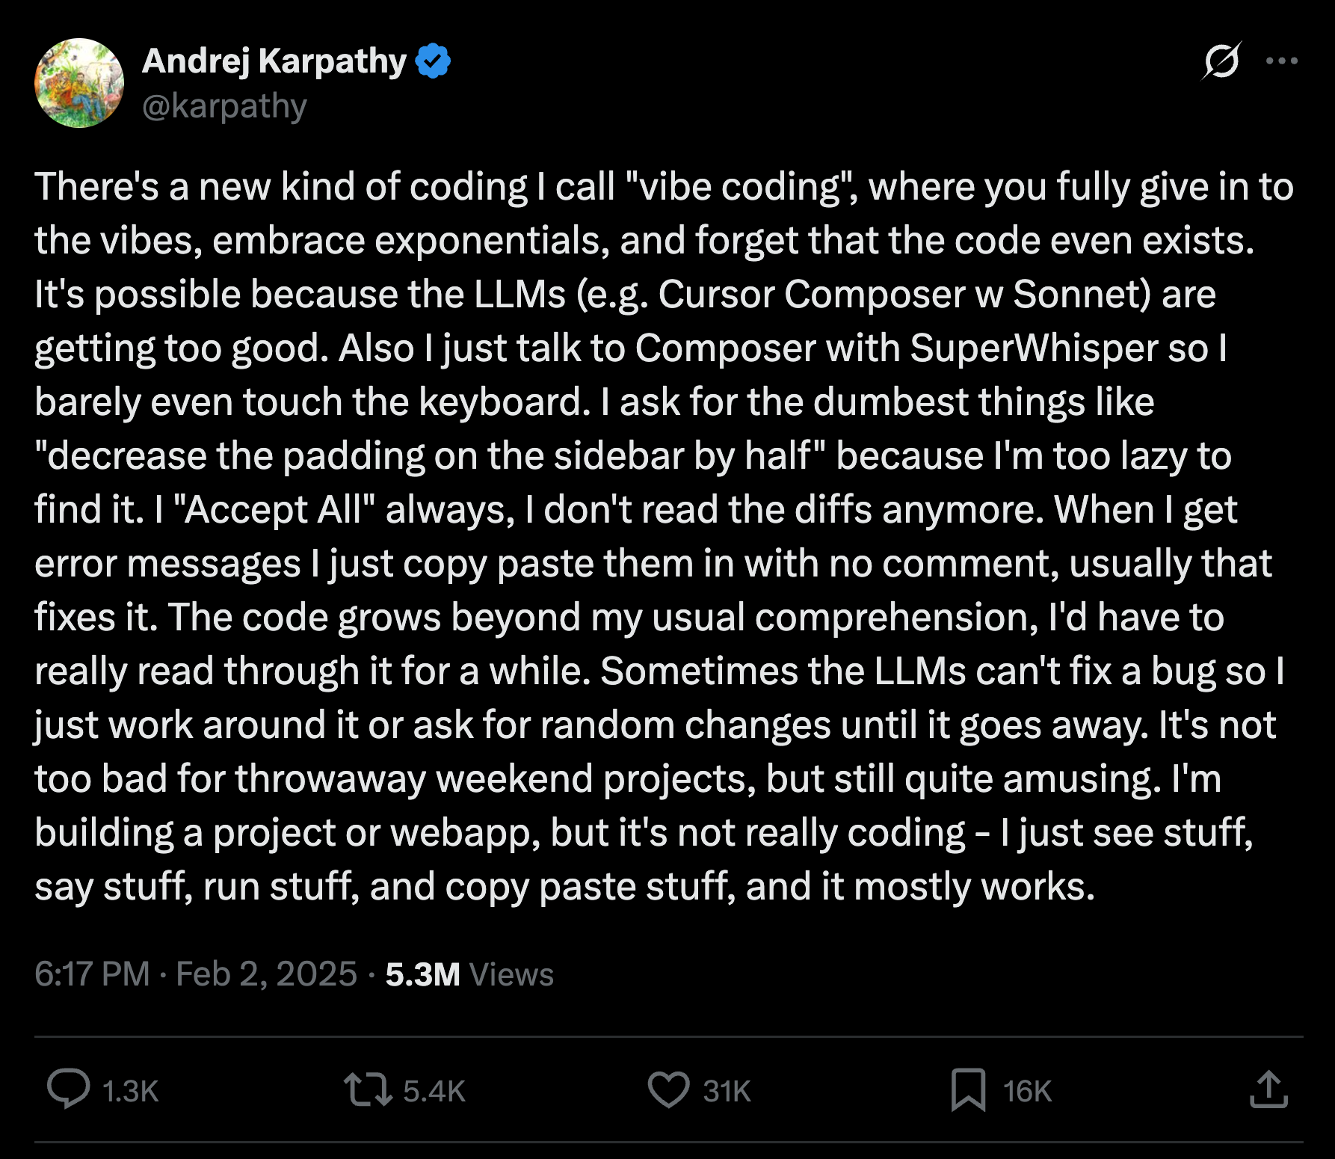
Karpathy Tweets

Slide 4
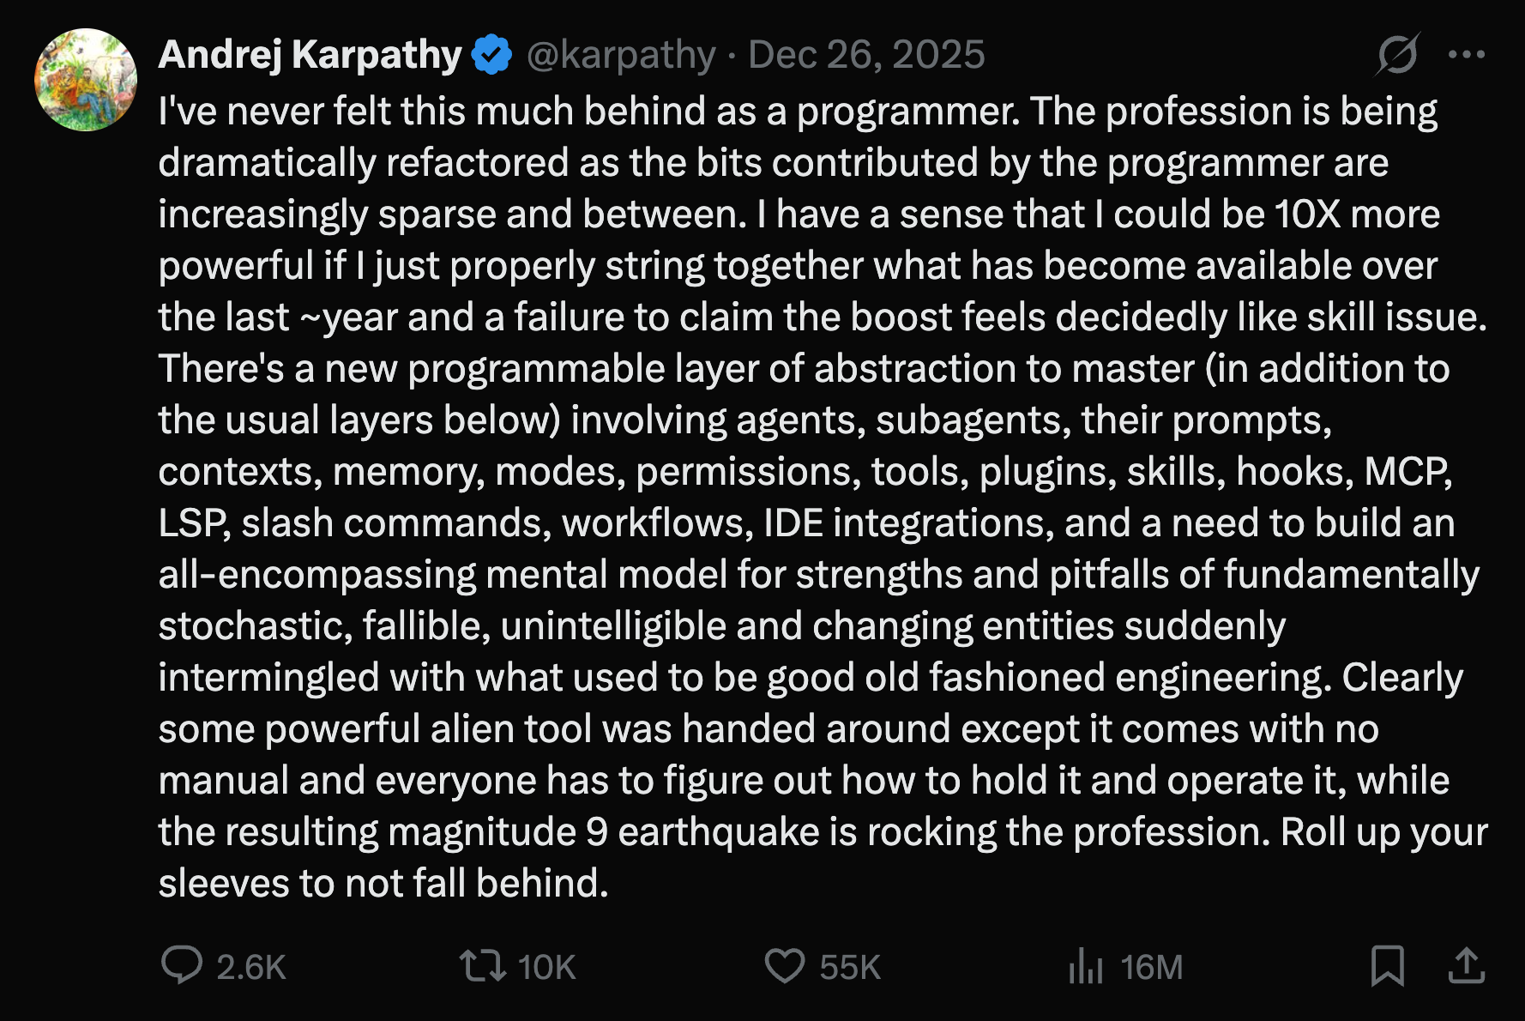
Karpathy Tweets

Slide 5
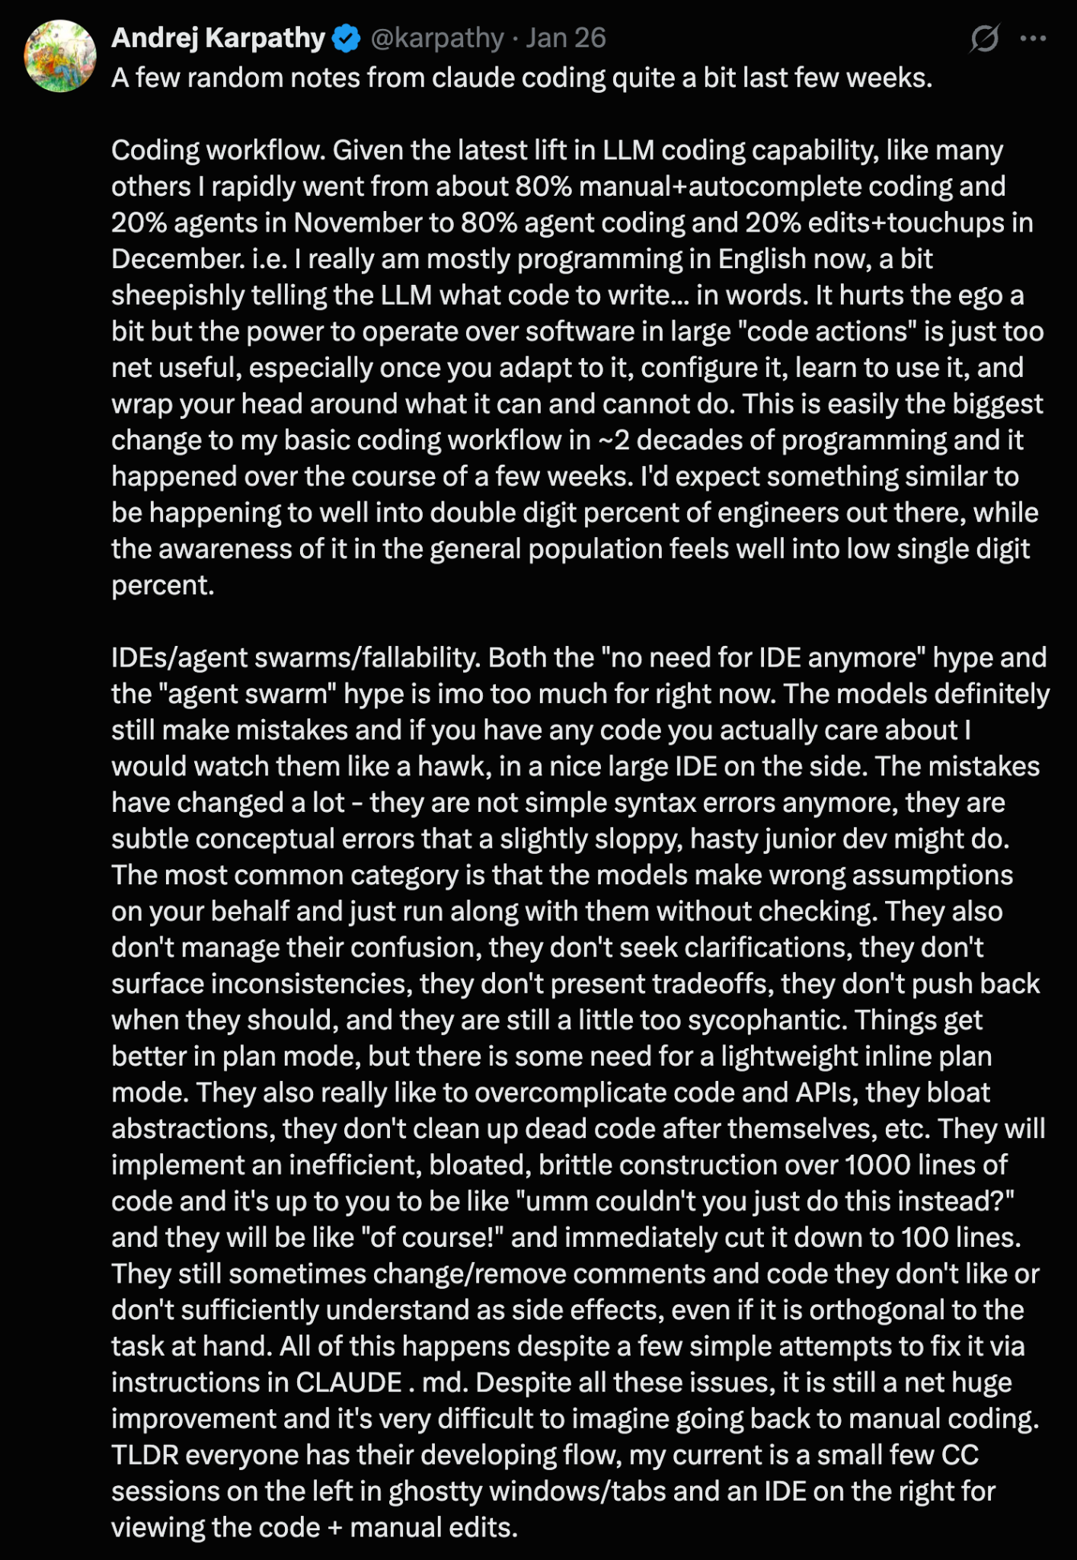
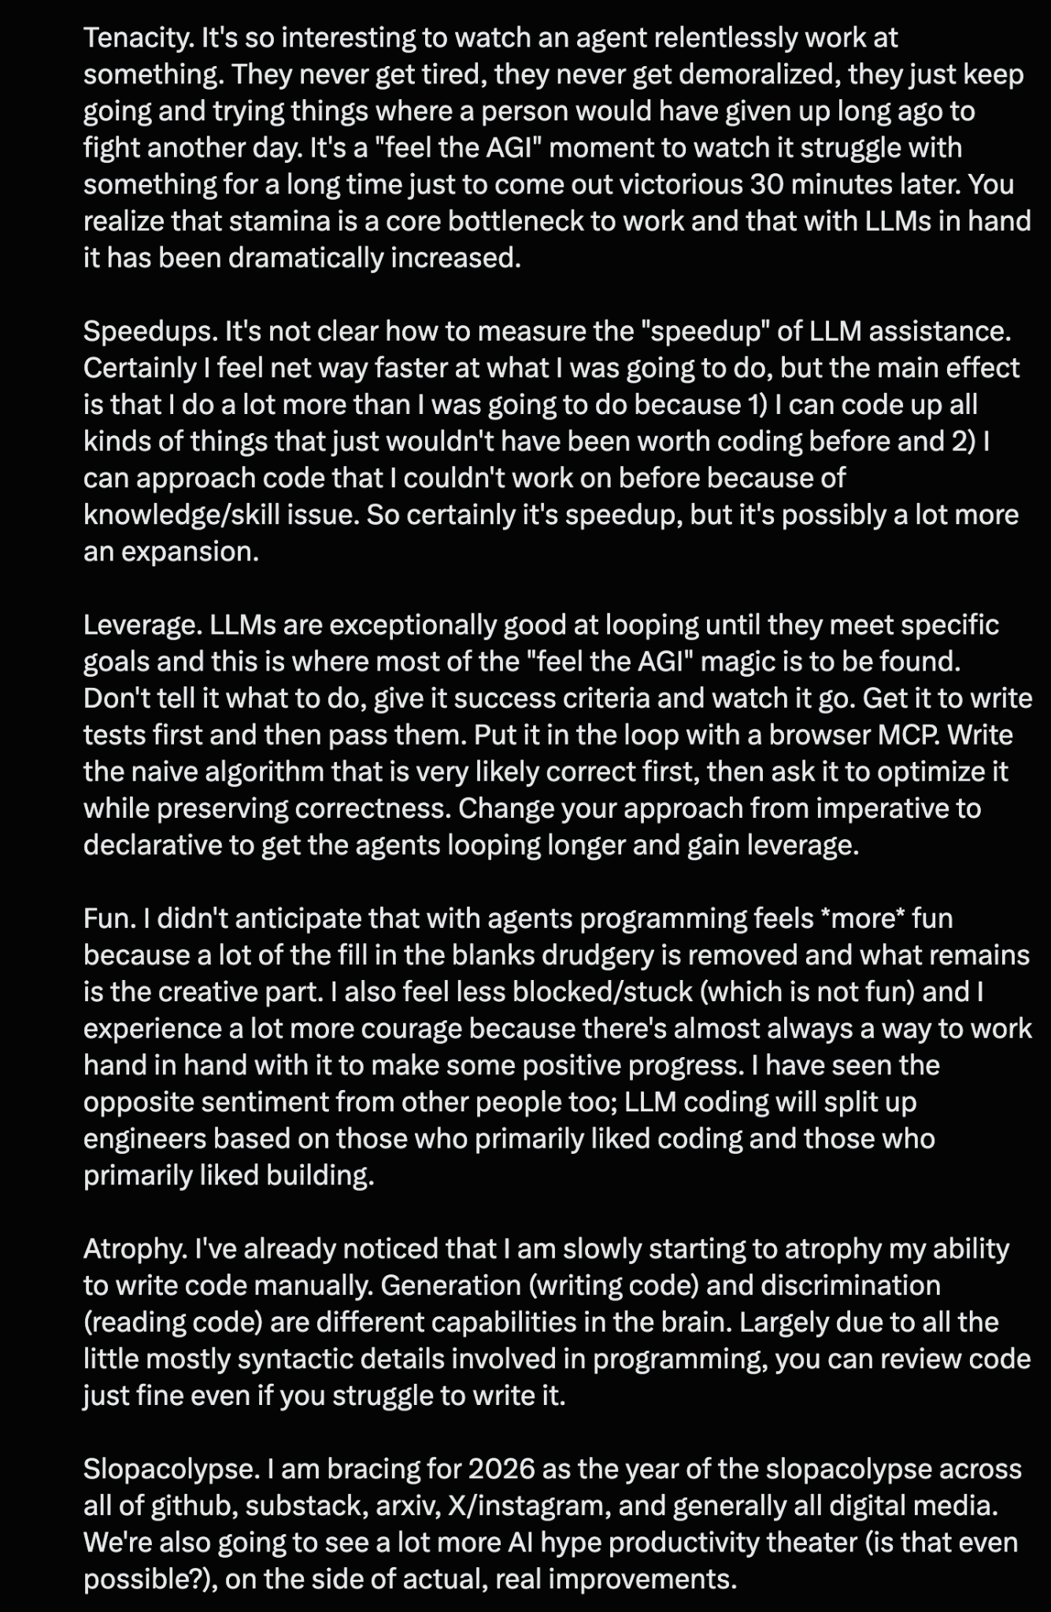
Karpathy Tweets

Slide 6





For Success: Be The Boss
Invest in AGENTS.md
Concisely: spec, style, success
Start SIMPLE
Work incrementally; test constantly; validate success criteria
Don’t get lazy - challenge & demand evidence
Handle frustration with style

Slide 7



For Success: Be The Boss
For Junior Engineers:
Keep learning
Be skeptical
For Senior Engineers:
Keep building
Keep enjoying
For everyone:
Expect mixed results - recognize the downside; it’s a net positive

Slide 8


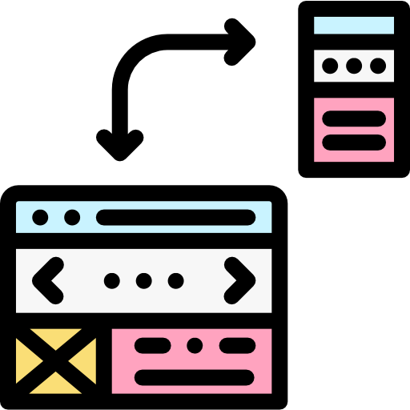
FRONTEND vs BACKEND
Covering some foundations..
Frontend vs Backend in a web app
Frontend
Backend
Frontend+Backend
Runs in user’s browser
Runs on the server
API contract over HTTP
HTML (structure) CSS (appearance) Javascript (interactivity)
Business logic, database access, LLM calling, other APIs, secrets
The backend exposes HTTP endpoints, called by the frontend;
the backend can also serve the frontend code to browser

Slide 9



With apologies to the Frontend developers amongst us..
Frontend progression
Vanilla HTML
HTML + CSS + Javascript + low level libraries like jQuery
The “DOM” = object representation of the page
Frontend Frameworks like React
React, Vue, Angular, Svelte - reusable components
SPA - loads page once and dynamically updates
Come in Javascript variants, and its sister language Typescript
Application Frameworks like Next.js
Adds routing, data fetching, server-side rendering and more
Tooling, such as bundling
JS or TS

Slide 10






Introducing Docker
What is it
Why
A box within your box
Isolated, portable
A lightweight alternative to VMs that shares the host’s OS
Run the same software everywhere
Dockerfile
Image
Container
Recipe
Snapshot
A live instance
A text file with instructions for installing & configuring
Created by building a Dockerfile and ready to be made live
A running isolated environment created from an image

Slide 11
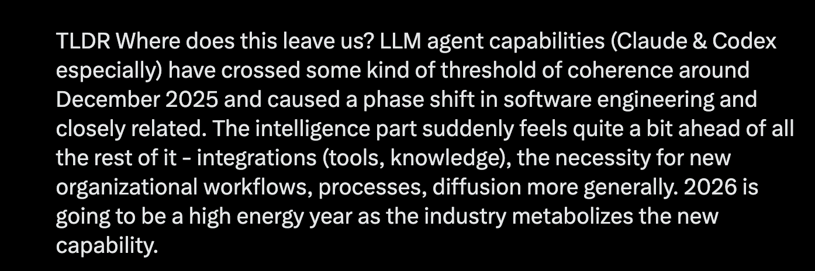
Karpathy Tweets

Slide 12
3 Weeks to Expert Agentic Coder
Core skills
Products / Features
Projects
Week 3: Agentic Engineering as an expert
Multi-Agents
Sub-Agents
Hooks
Sandboxing
Large Codebase
Workflow
Swarms
Orchestrators
Project 4: Capstone
Week 2: Vibe Engineering as a professional
Claude Code
OpenCode
others
Commands
Checkpoints
Ralph Loops
MCP
Skills
Plugins
Workflows
Team
Debugging
Project 3: SaaS Platform
Week 1: Vibe Coding for fun and profit
Agentic Coding Landscape
Foundations
AGENTS.md
Context
Cursor
Copilot, Codex
Antigravity
Project 1: YOLO
Project 2: Commercial MVP

Slide 13

AI Coder: Vibe Coder to Agentic Engineer
The Missing Manual
33%
Complete

